Slide 1

PREDICTING SEVERITY OF ACCIDENT IN FRANCE USING AI SYSTEMS
Edwin Mogondo
B.E Chemical Engineer
IBM Data Science Program
10/13/2020

Slide 2
Predicting Accidents is Very Important to both the Economy and Society at Large.
Transport systems and government are entrusted by the people to protect them. One of the way that government can help protect them is by reducing the number of road accidents and by coming with ways to allocate resources (money, labor and capital) properly.
By knowing the amount of labor, equipment or how much money is needed can help improve response time, equipment allocation which can save more lives and improve the economy.
Predicting severity of accidents help first responders and transport systems.
To deploy proper equipment needed during crashes.
To allocate money, improve infrastructure and much more.

Slide 3
Data Acquisition and Cleaning
This France Accident Data was collected between 2005-2016 and available on Kaggle.com
There are 3 coma separated files: users.csv, characteristics.csv and places.csv
Places and characteristics files have 839,985, and users have 1,876,005 rows and 16, 18 and 12 features in the raw datasets respectfully.
Duplicate, highly similar or highly correlated features were dropped.
Cleaned data contains 5 features.

Slide 4
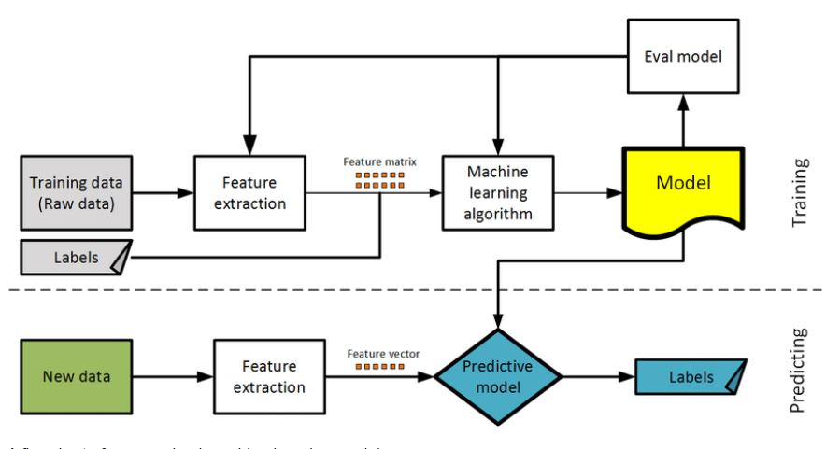
Machine Learning Model Building Diagram

Slide 5
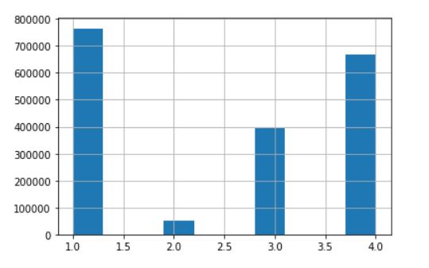
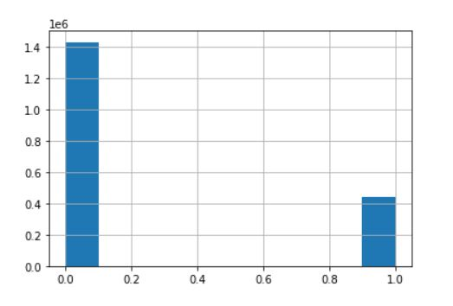
Distribution of Severity in Raw and Cleaned Data
Raw Data
Transformed Categorical Data
These feature represents severity (“grav”)
1: Unscathed
2. Killed
3. Serious injury
4. Light injury
These feature represents severity (“grav”)
0: Unscathed and light
1: Serious injury and killed

Slide 6
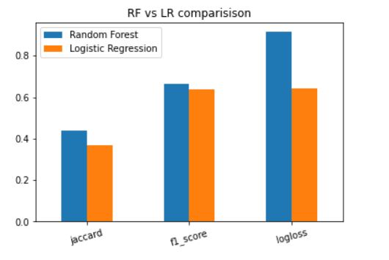
Jaccard, F1-Score and Log Loss
Random Forest (LR) performed better overall in the three tests therefore making it the best predictor.
Jaccard Score: LR : 36.7% RF: 44.0%
f1-score Score: LR : 63.9% RF: 66.9%
Log Loss: LR : 64.2% RF: 91.4%

Slide 7
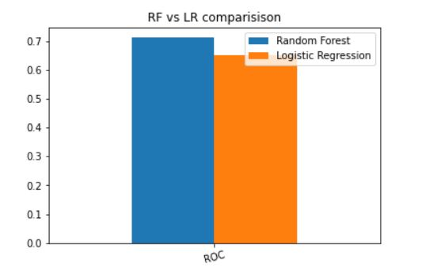
Area Under ROC Curve
Random Forest (RF) with 71.6% was better than Logistic Regression(LR) with 65.1% when ROC test was performed.
ROC Curve: LR 65.1% RF: 71.6%

Slide 8
Summary & Conclusion
Continue to Collect more data and train
Random forest can help the government of France to solve road accidents
Accuracy has room for improvement given more data
Test other models:
Support Vector MAchine
Naïve Bayes
AdaBoost Classification Tree

